Slide 1

Essentials of Cryptography
Debdeep Mukhopadhyay
and Mainack Mondal
CS 60065
Autumn 2019

Slide 2
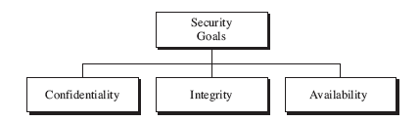
The Three Goals
Confidentiality: hiding information from unauthorized access
Integrity: preventing information from unauthorized modification
Availability: should be easily available to authorized users

Slide 3

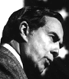

Goals of Cryptography
Confidentiality
Dear Alice,
Bob
Alice
Eve
Integrity
Availability

Slide 4
Techniques: Cryptographic Algorithms
encrypt
decrypt
plaintext message
plaintext message
ciphertext
SENDER
Key
(e)
Key
(d)
RECEIVER
retreat at dawn
sb%6x*cmf
retreat at dawn
ciphertext
ATTACKER

Slide 5
Confidentiality
Information is exchanged over the un-trusted network.
Information, while exchange, should remain secret.
Confidentiality related to both the storage as well as transmission of information.

Slide 6
Integrity
Information is always changing.
But the change should be made by authorized users
modification: change made by unauthorized users.
Need techniques to ensure the integrity of data:
preventing the modification
detect any modification made

Slide 7
Availability
Confidentiality and Integrity should not hinder the availability of data.
Data must be available to authorized users.
Cryptographic mechanisms should have a small overhead.

Slide 8
Definitions
A cipher or cryptosystem is used to encrypt the plaintext
The result of encryption is ciphertext
We decrypt ciphertext to recover plaintext
A key is used to configure a cryptosystem
A symmetric key cryptosystem uses the same key to encrypt as to decrypt
A public key cryptosystem uses a public key to encrypt and a private key to decrypt.

Slide 9
Kerckhoffs Principle
Basis assumption
The system is completely known to the attacker
Only the key is secret
Also known as Kerckhoffs Principle
Crypto algorithms are not secret
Why do we make this assumption?
Experience has shown that secret algorithms are weak when exposed
Secret algorithms never remain secret
Better to find weaknesses beforehand

Slide 10
Cryptographic Communication
key
key
plaintext
encrypt
decrypt
plaintext
ciphertext
A generic use of crypto

Slide 11
Shift cipher
Consider,
P=C=K=Z₂₆.
For 0≤K≤25, define
e_{K}(x)=x+K mod 26
d_{k}(x) = y-K mod 26
(x,y Є Z₂₆)
It is easy to see that, x=d_{K}(e_{k}(x)).

Slide 12
Simple Substitution
Plaintext: fourscoreandsevenyearsago
Plaintext
a | b | c | d | e | f | g | h | i | j | k | l | m | n | o | p | q | r | s | t | u | v | w | x | y
D | E | F | G | H | I | J | K | L | M | N | O | P | Q | R | S | T | U | V | W | X | Y | Z | A | B
z
C
Ciphertext
Ciphertext:
IRXUVFRUHDAGVHYHABHDUVDIR
Shift by 3 is “Caesar’s cipher”
Note that the use of smaller letter for plaintext and capital letters for ciphertext is only to improve readibility

Slide 13
Properties required of the encryption
Each of encryption and decryption function should be easily computable.
An opponent, on seeing a ciphertext string y, should be unable to determine the key K, that was used, or the plaintext string x.
“Cryptanalysis” is the process of attempting to know the key from given information.

Slide 14
Cryptanalysis: Try all possibilities
Ciphertext: JBCRCLQRWCRVNBJENBWRWN
Try all the 26 possible keys (Exhaustive or brute force search)
jbcrclqrwcrvnbjenbwrwn
iabqbkpqvbqumaidmavqvm
hzapajopuaptlzhclzupul
…
astitchintimessavesnine: key = 9

Slide 15
Substitution Cipher
Key is some permutation of letters
Need not be a shift
For example
Plaintext
a | b | c | d | e | f | g | h | i | j | k | l | m | n | o | p | q | r | s | t | u | v | w | x | y
J | I | C | A | X | S | E | Y | V | D | K | W | B | Q | T | Z | R | H | F | M | P | N | U | L | G
z
O
Ciphertext
Then 26! ≈ 4 x 10²⁶ > 2⁸⁸ possible keys!
But still the cipher can be attacked quite easily.

Slide 16
The Affine Cipher
Let P = C = Z₂₆, let
K = {(a, b) ∈ Z₂₆ × Z₂₆ | gcd(a, 26) = 1}.
∀x∈P, ∀y∈C, ∀K ∈K, define
e_{K}(x) = ax + b (mod 26)
and
d_{K}(y) = a⁻¹(y – b) (mod 26).
The encryption is injective if and only if gcd(a,26)=1

Slide 22
Multiplicative Inverse of an Element
Suppose a is an element from Z_{m}. Then the multiplicative inverse of an element is an element b also in Z_{m}, such that ab=1 (mod m).
Then, gcd(a,m)=1
Note that if m=prime number, p then every element has an inverse. Then Z_{p} is called a field.

Slide 23
Inverse of Affine Cipher
Affine Cipher is invertible if a has a multiplicative inverse.
That is gcd(a,m)=1
{1,3,5,7,9,11,15,17,19,21,23,25} have elements which are co-prime to m
Thus, 1⁻¹=1, 3⁻¹=9, 5⁻¹=21, 7⁻¹=15, 11⁻¹=19, 15⁻¹=7, 17⁻¹=23, 25⁻¹=25
Thus, the inverse of an element belongs to the above set. Why?

Slide 24
Key Size of Affine Cipher
The possible values of a such that gcd(a,26)=1 are:
{1,3,5,7,9,11,15,17,19,21,23,25}
Thus, there are 12 possible a’s
The coefficient b can be any 26 value: Total key size is 12 x 26 = 312
Key size is thus too small…can we generalize the affine cipher?

Slide 25
Computing Φ
The number of positive integers in Z_{m} (m>1), that are relatively prime to m and does not exceed m is denoted by Φ(m), called Euler’s Totient function or phi function.
If m and n are relatively prime numbers,
Φ(mn)= Φ(m) Φ(n)
Φ(77)= Φ(7 x 11)=6 x 10 = 60
Φ(1896)= Φ(3 x 8 x 79)=2 x 4 x 78 =624
This result can be extended to more than two arguments comprising of pairwise co-prime integers.

Slide 28
Computing Φ (contd.)
If m and n are relatively prime numbers,
Φ(mn)= Φ(m) Φ(n) [stated without proof, interested students see: https://www.youtube.com/watch?v=SCvtxjpVQms&list=PL71FE85723FD414D7&index=3]
Φ(77)= Φ(7 x 11)=6 x 10 = 60
Φ(1896)= Φ(3 x 8 x 79)=2 x 4 x 78 =624
This result can be extended to more than two arguments comprising of pairwise coprime integers.

Slide 29
Computing Φ (contd.)
Φ(pª)=pª-p^{a-1}
Evident for a=1
For a>1, out of the elements 1, 2, …, pª the elements p, p², p^{a-1}p are not co-prime to pª.
Rest are co-prime.
Thus Φ(pª)=pª-p^{a-1}
=pª(1-1/p)

Slide 30
Computing Φ (contd.)
n=p₁^{a1}p₂^{a2}…p_{k}^{ak}
Thus, Φ(n)= Φ(p₁^{a1}) Φ(p₂^{a2}) … Φ(p_{k}^{ak})
=n(1-1/p₁)(1-1/p₂)…(1-1/p_{k})
Thus, if m=60=4x3x5
Φ(60)=60(1-1/2)(1-1/3)(1-1/5)=16
Hence, number of Affine keys = 16 x 60 = 960.

Slide 31
Monoalphabetic Ciphers
Once a key is chosen, each alphabetic character is mapped to a unique alphabetic character in the ciphertext.
Example: Shift and Substitution Cipher

Slide 32
Types of Attacks
Attacks
BruteForce Attack
Analytical Attacks
Social Engineering
Implementation Attacks

Slide 33
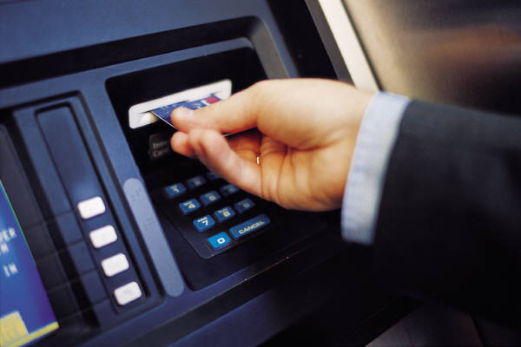
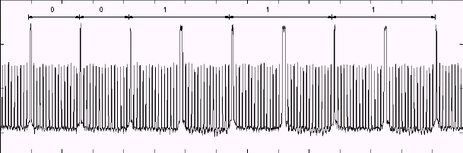
Implementation Attacks: Side channel attacks
Data input
Terminal
IC chip
Data output
Power supply
00111…
Measure power consumption
Guess secret information stored on IC chip memory
Power consumption
Secret information
0
0
1
1
1
1
Notes:
With side channel attacks it is possible to break implementations of cryptosystems even though no mathematical attack is known to solve the underlying problem. With SPA, one power trace is sufficient to reveal the secret.

